Slide 1


WEST YANGON TECHNOLOGICAL UNIVERSITY
MECHATRONIC ENGINEERING DEPARTMENT
1

Slide 2


PROJECT TITLES REPORT
Defense Seminar
Presented By
V McE Group B
Date- 6.3.2024
2

Slide 3
TABLE OF CONTENTS
MEMBERS
01
List of group’s members
First Project
02
MotionMaster (The Hand-Guided Robotic Arm)
Second Project
03
RoboSort Arm (Automated RGB Color Sorting System)
Third Project
04
Robot Arm Car With Pan Tilt Camera Control
3

Slide 4
OUR GROUP MEMBERS
Yan Naing Kyaw Tint
Ngwe Thant Sin
Ye Mann Kyaw
Thaw Zin Paing
Our group has four members.
4

Slide 5


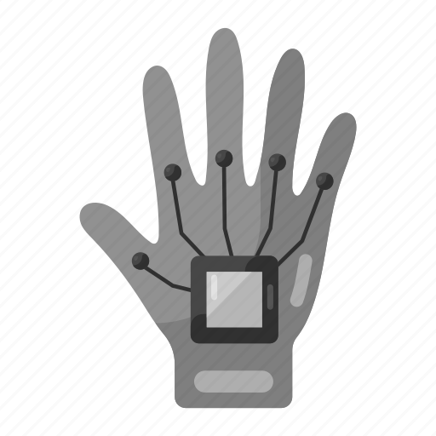
Our First Project
MotionMaster
(The Hand-Guided Robotic Arm)
5

Slide 6
MotionMaster
(The Hand-Guided Robotic Arm)
The system, featuring portability and wireless control, incorporates servo motors, Arduino microcontrollers, flex sensors, and accelerometers for precise gesture recognition.
With a maximum load capacity of 1kg, the system demonstrates practical utility for various manipulation tasks. This project showcases the potential of gesture-controlled robotics for applications in industry, education, and research.
This project introduces a gesture-controlled six-axis robotic arm utilizing a wearable robotic glove interface by mimicking natural human gestures such as pinching or wrist rotations, users can intuitively manipulate the robotic arm movements in real-time.
6

Slide 7
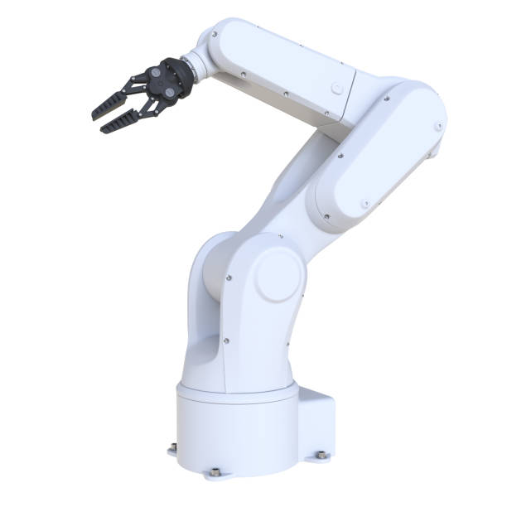
Purpose of The Hand-Guided Robotic Arm
The purpose of this robotic system extends beyond conventional applications, aiming to in hazardous environments such as bomb disposal, space exploration, and underwater operations.
By integrating advanced technologies and continuous improvement, it seeks to enhance safety and efficiency in these high-risk scenarios.
This technology enables intuitive gesture control to operate robotic arms, providing a vital interface for remote operation and manipulation in dangerous situations.
It aims to support astronauts in extraterrestrial exploration, and assist in deep-sea exploration and maintenance.
With ongoing advancements and enhancements, the system strives to push the boundaries of human-robot interaction, making significant contributions to safety, exploration, and discovery in extreme environments.
7

Slide 8
Space Exploration
"Our robot arm revolutionizes space exploration, augmenting human capabilities in environments where human presence is limited or impractical.
It deploys instruments, repairs spacecraft, and assembles structures with precision, enduring extreme conditions like vacuum, radiation, and temperature fluctuations."
Main Application Areas
Our Robot arm can be used in various applications such as Manufacturing and assembly, Healthcare, Hazardous Environment and Space Exploration.
Our primary focus lies in hazardous environments and space exploration, where the need to minimize human risk is paramount.
Hazardous Environment
"Our robot arm is ideal for hazardous environments like bomb disposal, nuclear facilities, and underwater exploration, where human safety is at risk. "
8

Slide 9
Components List of The Hand-Guided Robotic Arm
Gesture Gloves (Master Control Region)
Flex Sensor
Accelerometer (MPU6050)
Arduino Nano
Bluetooth Module (HC05)
Robotic Arm (Servan Region)
Arduino Uno
Bluetooth Module (HC05)
Servo Driver (PCA9685)
Servo Motors (MG966R)
Stepper Motor Driver (A4988)
Stepper Motor (NEMA 17)
9

Slide 10
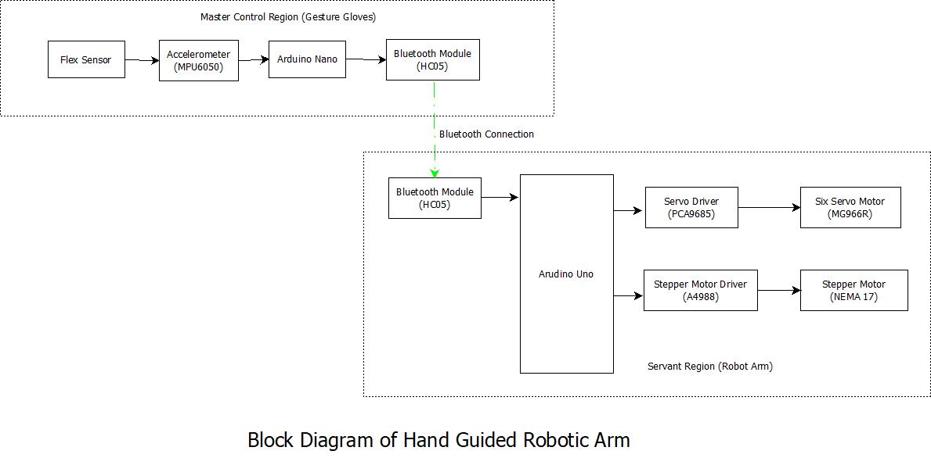
10

Slide 11

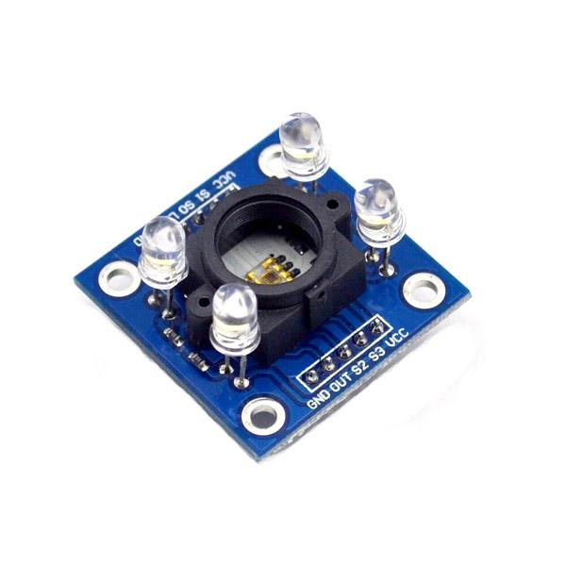
Our Second Project
RoboSort Arm
(Automated RGB Color Sorting System)
11

Slide 12

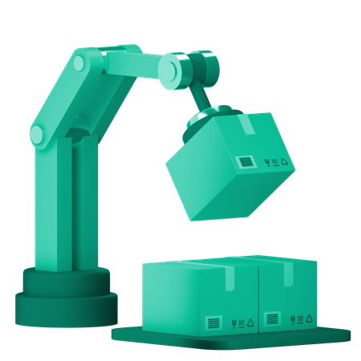
RoboSort Arm
(Automated RGB Color Sorting System)
Incorporating two MG996R and three SG90 motors, an Arduino Uno board, and a TCS3200 color sensor module, this system epitomizes precision engineering and automation.
This abstract provides an overview of the design, implementation of the sophisticated color sorting system, emphasizing its functionality and practicality in industrial environments.
In an era characterized by automation and efficiency, the demand for advanced sorting solutions in industrial settings has surged. In response to this need, this project introduces a novel robotic arm integrated with a conveyor belt system for automated color sorting.
12

Slide 13
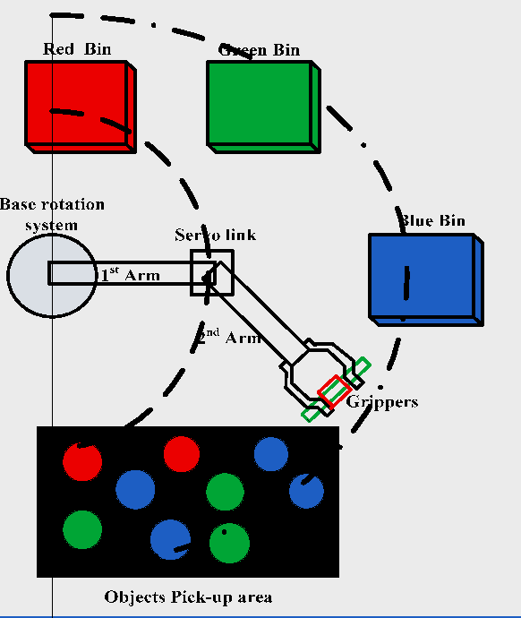
Purpose of RoboSort Arm
The purpose of this project is to develop an automated robotic arm system capable of sorting objects based on their red, green, and blue (RGB) colors.
By integrating advanced technologies such as motors, a color sensor module, and an Arduino board, the system aims to demonstrate precision engineering and automation capabilities.
The ultimate goal is to provide a practical solution for industrial settings where efficient color sorting is essential, thereby improving productivity and reducing manual labor.
13

Slide 14

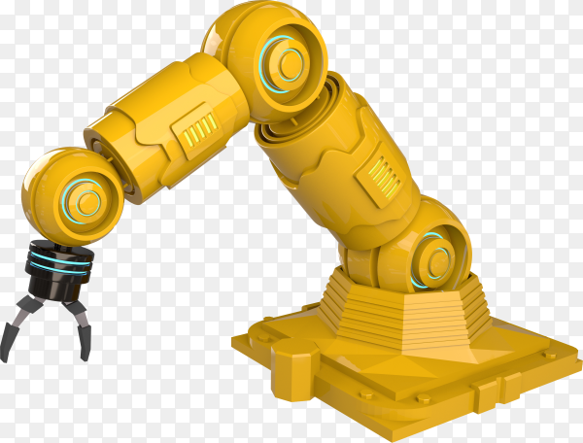
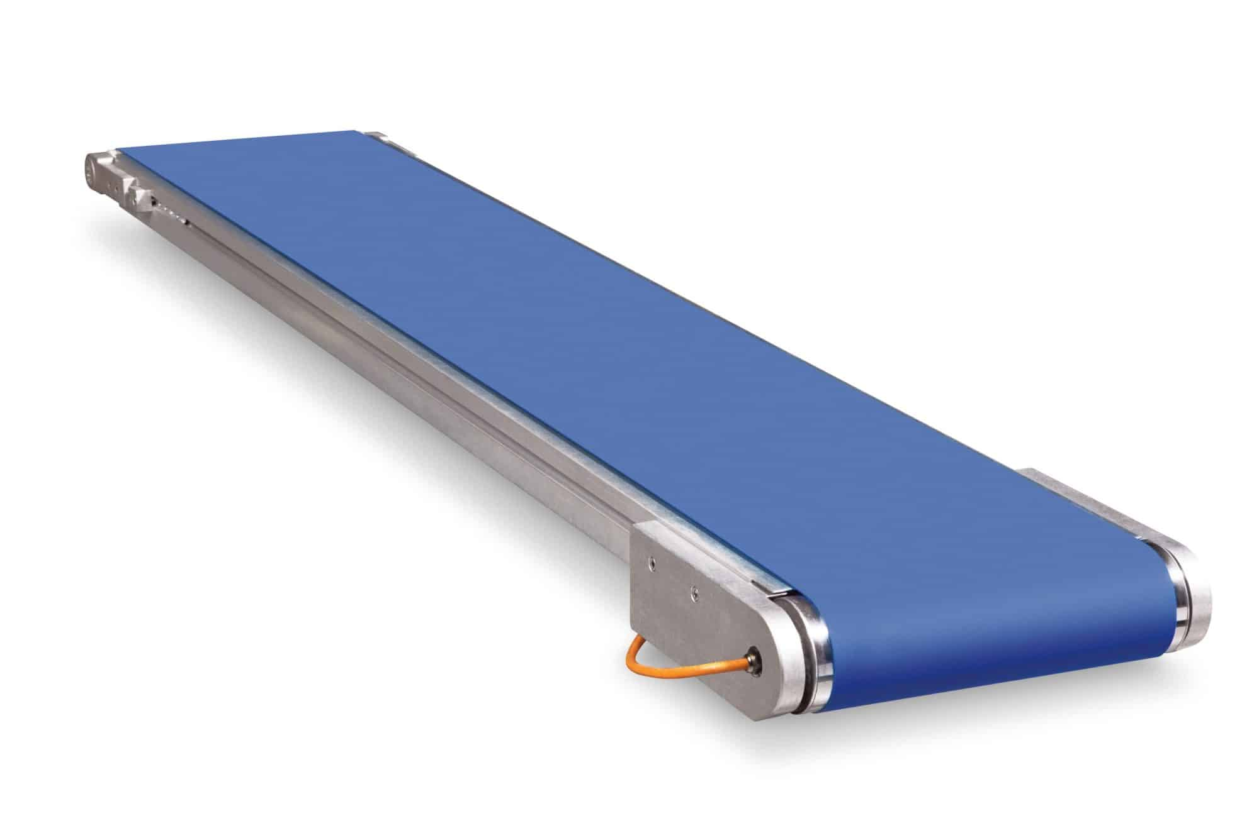

Application Area
In the production of garments and textiles, color sensors are integrated into sorting systems to categorize materials based on color. This ensures that only materials with the correct color specifications are used in the manufacturing process.
The RGB color sorting robotic arm has a wide range of potential application areas.
In those, we are going to use our project in
Textile Industry
In garment manufacturing, robotic arms can be used to sort assemble pieces of fabric based on color, enabling faster and more precise production of garments.
Robotic arms can be programmed to match different colored fabrics, ensuring that the final product meets specific design requirements.
14

Slide 15


Components List of Robosort Arm
Hobby Servo Motor * 2
Micro Servo Motor * 4
Color Sensor
Arduino Uno
Battery * 4
Battery Holder
Bread Board
Conveyor Belt
15

Slide 16
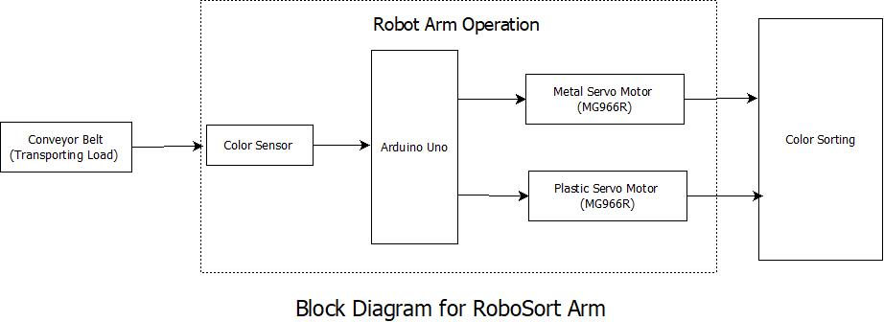
16

Slide 17
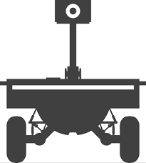
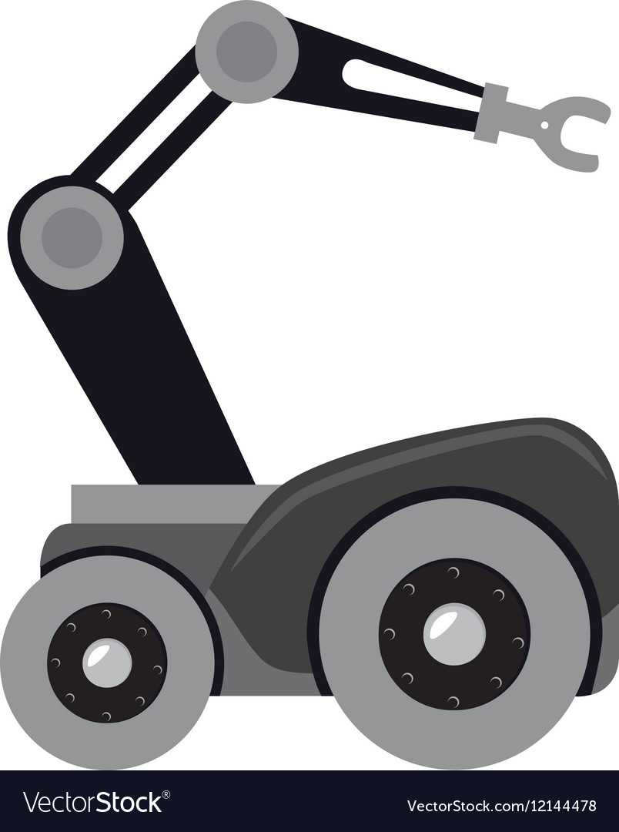
Our Third Project
Robot Armed mounted Car With Pan Tilt Camera Control
17

Slide 18
Robot Armed mounted Car With Pan Tilt Camera Control
The L298N motor driver module ensures efficient power management, while a UBEC or Buck Converter supplies the necessary 5V to the servo motors.
The project also includes a pan-tilt camera system utilizing an ESP32 CAM module and a Micro Servo 9g SG90, controlled through Arduino IDE.
By combining these components, the robot car not only offers mobility but also the capability for remote surveillance and manipulation, in various fields, including home automation, security, and education.
The project aims to create a versatile robot car equipped with an articulated arm and surveillance camera system, controlled via an ESP32 module.
The robot car, assembled using components such as servo motors, DC gear motors, wheels, and a wooden chassis, integrates seamlessly with a PS3 controller for intuitive operation.
18

Slide 19
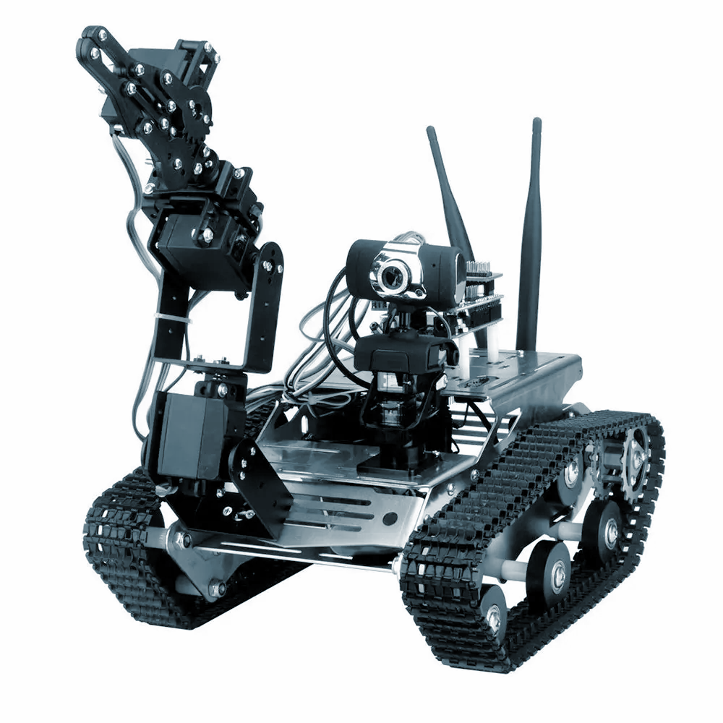
Purpose of This project
The purpose of this project is to design and build a versatile robot car equipped with an articulated arm and surveillance camera system, specifically tailored for applications in inaccessible or hazardous environments such as mining, construction, and cave exploration. The primary goal is to enhance safety and efficiency by enabling remote exploration, surveillance, and inspection of areas that are challenging or dangerous for humans to access.
19

Slide 20
Application Area
3. Cave Exploration and Search-and-Rescue:
Leveraging the robot car's ability to traverse rugged terrain and explore tight passages in cave systems. Equipped with a surveillance camera, it provides real-time video feed to aid in mapping, locating trapped individuals, or identifying valuable resources.
By deploying the robot car in these specific application areas, industries can improve efficiency, safety, and productivity while minimizing risks to human workers.
1. Mining Exploration:
Utilizing the robot car equipped with an articulated arm and surveillance camera system to navigate through narrow tunnels, unstable terrain, and hazardous environments in mining operations.
2. Construction Site Management:
Deploying the robot car to survey construction sites, inspect hard-to-reach areas of buildings or structures, and perform tasks such as drilling or welding in locations where human access is limited or unsafe.
20

Slide 21
Components List of Robot Armed Mounted Car with Pan Tilt Camera Control
Components list for robot car
with arm mounted
Robot Arm Kit
Servo motors - 4
ESP32 module
PS3 Controller
4 DC gear motors
4 Wheels
Wooden plate for car chassis
L298N motor driver module.
7-12 V DC battery
Jumper wires
Pan Tilt Camera Control
Arduino IDE
ESP32 CAM
Pan and Tilt Camera Mount
Micro Servo 9g SG90
21

Slide 22
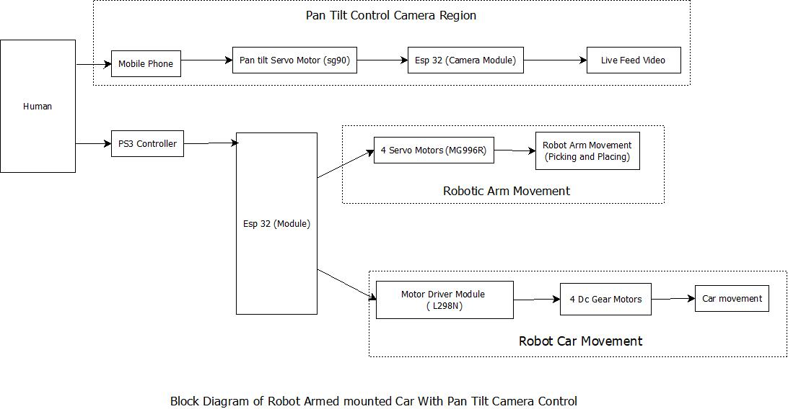
22

Slide 23


23

